Slide 1
Data Presentation
Marketing Analytics Portfolio Project
Ecem BAYINDIR

Slide 2
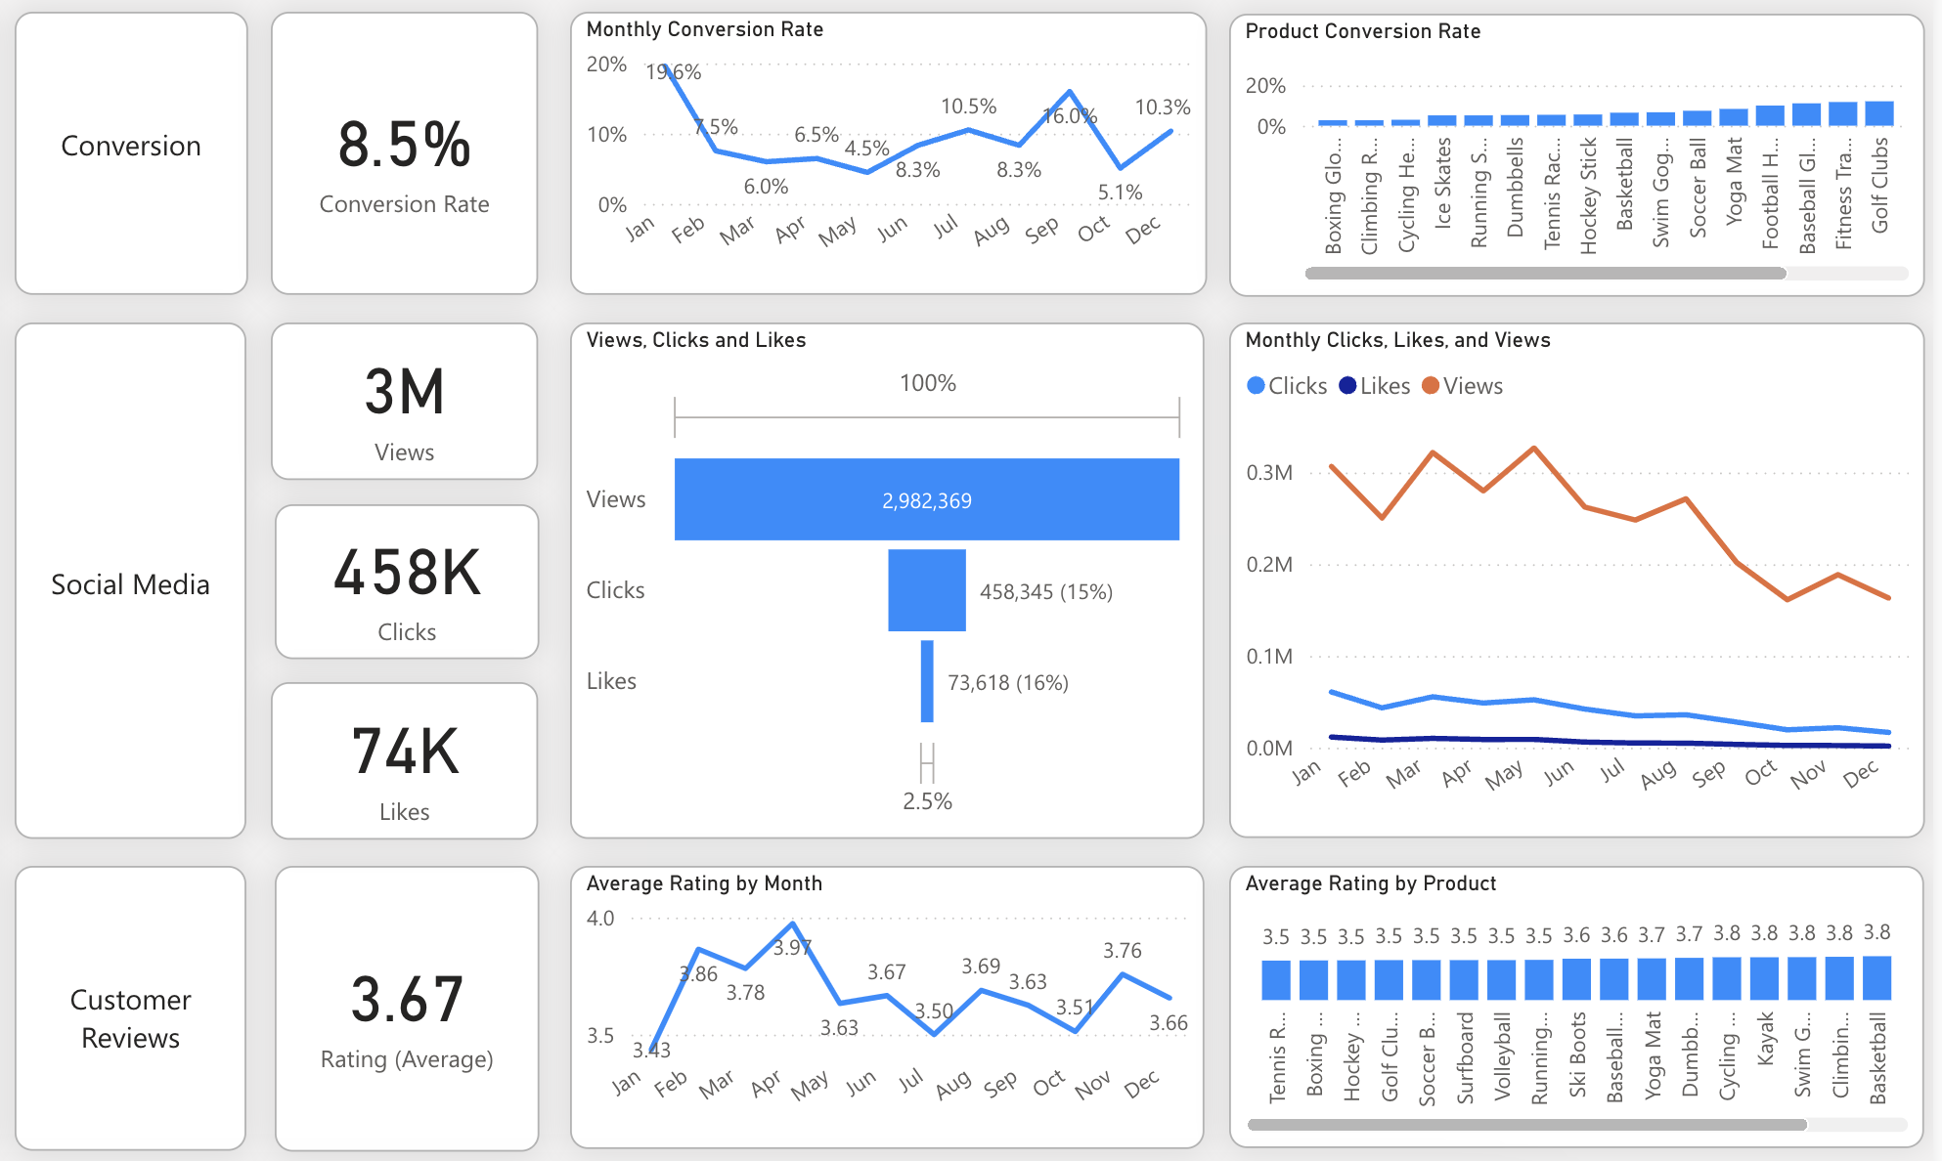
Overview
Decreased Conversion Rates: The conversion rate demonstrated a strong rebound in December, reaching 10.2%, despite a notable dip to 5.0% in October.
Reduced Customer Engagement:
There is a decline in overall social media engagement, with views dropping throughout the year.
While clicks and likes are low compared to views, the click-through rate stands at 15.37%, meaning that engaged users are still interacting effectively.
Customer Feedback Analysis:
Customer ratings have remained consistent, averaging around 3.7 throughout the year.
Although stable, the average rating is below the target of 4.0, suggesting a need for focused improvements in customer satisfaction, for products below 3,5.

Slide 3
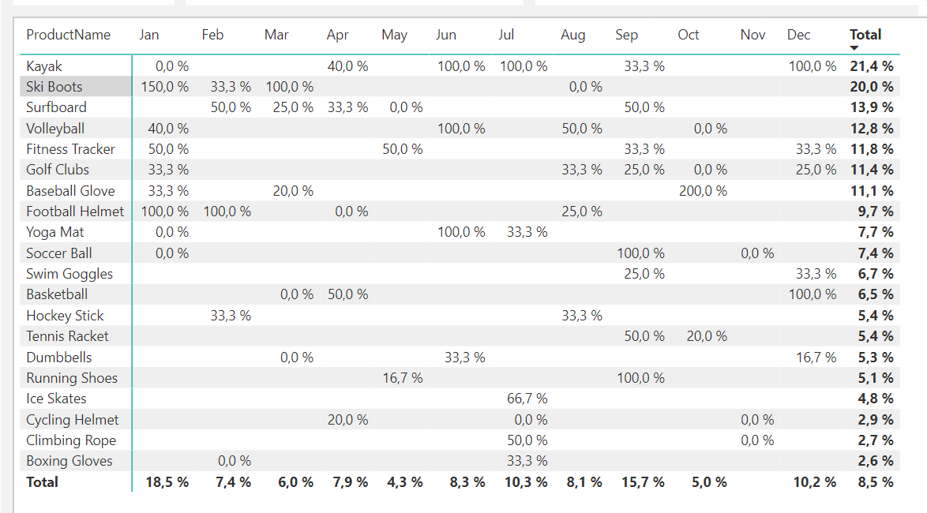
Decreased Conversion Rates
General Conversion Trend:
Throughout the year, conversion rates fluctuated, with a higher number of products successfully converting in February and July. This indicates that while some products experienced strong seasonal peaks, there is an opportunity to enhance conversions in the lower-performing months through targeted interventions.
Lowest Conversion Month:
In May, the overall conversion rate was the lowest at 4.3%, with no specific products significantly contributing to the conversion success. This suggests a potential need to reevaluate marketing strategies or promotions during this period to enhance performance.
Highest Conversion Rates:
January had the highest overall conversion rate at 18.5%, significantly driven by the Ski Boots, which achieved an impressive 150% conversion rate. This indicates a robust start to the year, likely fueled by seasonal demand and effective marketing strategies.

Slide 4
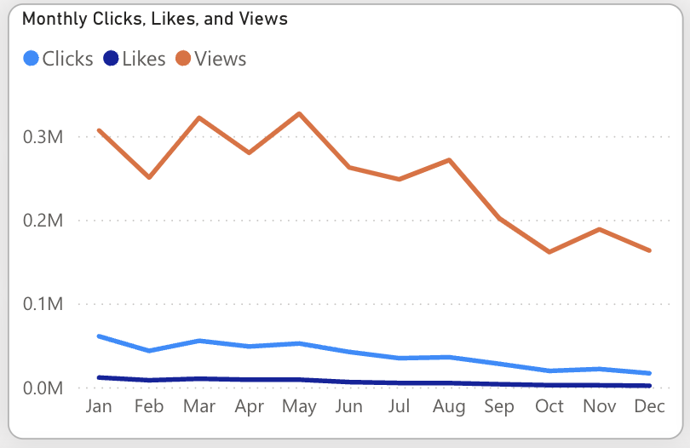
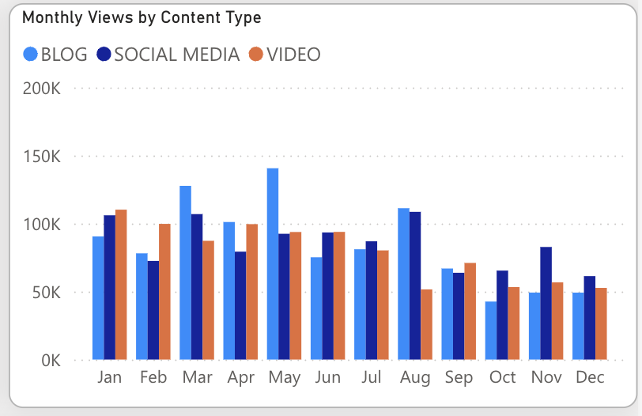
Reduced Customer Engagement
Declining Views:
Views peaked in February and July, but declined from August onward, indicating reduced audience engagement in the latter half of the year.
Low Interaction Rates:
Clicks and likes remained consistently low in comparison to views, indicating a need for more engaging content or stronger calls to action.
Content Type Performance:
Blog content generated the highest views, particularly in April and July, while social media and video content maintained consistent but slightly lower engagement levels.

Slide 5
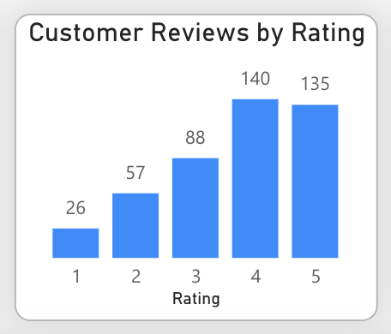
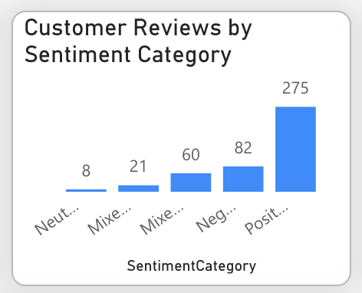
Customer Feedback Analysis
Customer Ratings Distribution:
Most customer reviews are positive, with 140 reviews giving 4 stars and 135 reviews giving 5 stars. In contrast, lower ratings (1-2 stars) represent a smaller portion: there are 26 reviews with 1 star and 57 reviews with 2 stars. Overall, the feedback is predominantly favorable.
Sentiment Analysis:
Positive sentiment prevails with 275 reviews, indicating a generally satisfied customer base. Negative sentiment appears in 82 reviews, with fewer mixed and neutral sentiments, suggesting areas for improvement but overall strong customer approval.
Opportunity for Improvement:
The existence of mixed positive and negative sentiments indicates opportunities to transform these mixed experiences into more distinctly positive ones, which could enhance overall ratings. By addressing the specific concerns present in mixed reviews, customer satisfaction could be improved.

Slide 6
Goals & Action
Goals
Action
Increase Conversion Rates:
Target High-Performing Product Categories: Focus marketing efforts on products with demonstrated high conversion rates, such as Kayaks, Ski Boots, and Baseball Gloves. Implement seasonal promotions or personalized campaigns during peak months (e.g., January and September) to capitalize on these trends.
Enhance Customer Engagement:
Revitalize Content Strategy: To turn around declining views and low interaction rates, experiment with more engaging content formats, such as interactive videos or user-generated content. Additionally, boost engagement by optimizing call-to-action placement in social media and blog content, particularly during historically lower-engagement months (September-December).
Improve Customer Feedback Scores:
Address Mixed and Negative Feedback: Implement a feedback loop where mixed and negative reviews are analyzed to identify common issues. Develop improvement plans to address these concerns. Consider following up with dissatisfied customers to resolve issues and encourage re-rating, aiming to move average ratings closer to the 4.0 target.
Increase Conversion Rates:
Goal: Identify factors impacting the conversion rate and provide recommendations to improve it.
Insight: Highlight key stages where visitors drop off and suggest improvements to optimize the conversion funnel.
Enhance Customer Engagement:
Goal: Determine which types of content drive the highest engagement.
Insight: Analyze interaction levels with different types of marketing content to inform better content strategies.
Improve Customer Feedback Scores:
Goal: Understand common themes in customer reviews and provide actionable insights.
Insight: Identify recurring positive and negative feedback to guide product and service improvements.

